Slide 1



Get Started (ch. 0 & 1): http://bit.ly/speech2018
Wifi: MSFTGuest Event Attendee Code: msevent931ca
We will start at 9:00 AM
Your vision, your results, your cloud
Mike Branstein, Director and Cloud Solutions Architect
Justin Kobel, Director Modern Workplace
Frank Wilkens, Account Executive, TN
Notes:
Turn your idea into a new app, reimagine an existing system, or create a hybrid cloud application with confidence, no matter the platform or where you are on the journey to the cloud.

Slide 2
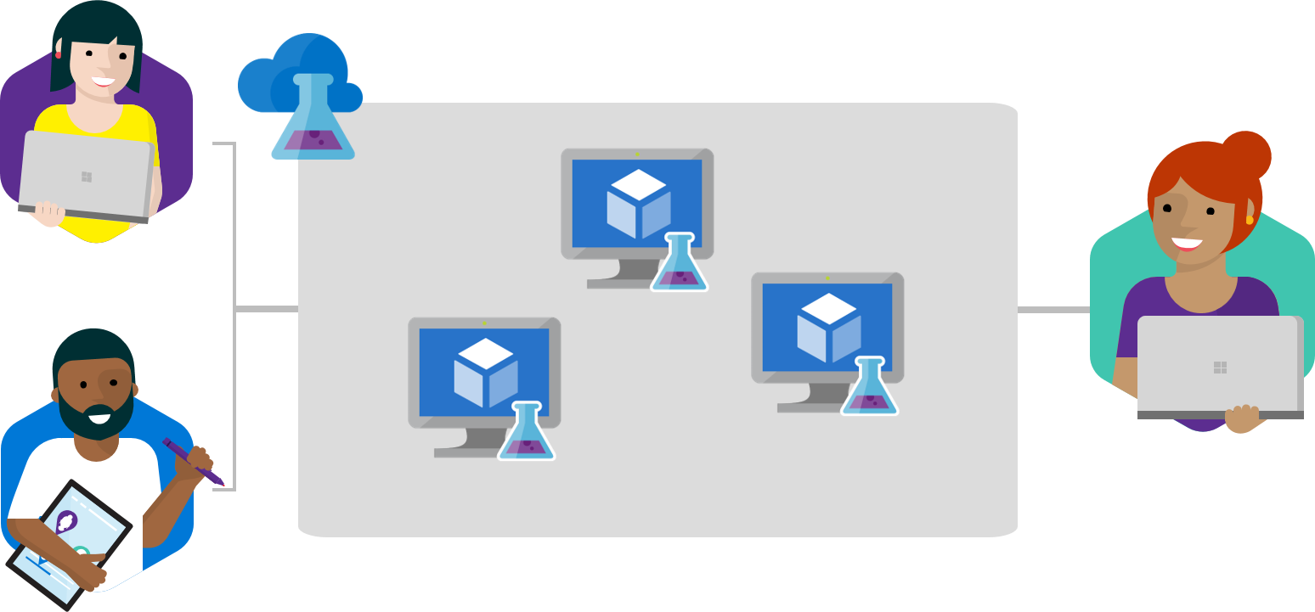
Real-World Scenarios What can you do with speech recognition and intent analysis?
Call center call interruption – quickly aligning customers with the right CSR
Determine purpose of short and long calls
Real-time chat bots that intelligently respond and search for answers

Slide 3




Speech Pipelines
“Pikachu sit down!”
Custom
Speech
Service
Language
Understanding
(LUIS)
Service
{“result”:
”pikachu sit down”}
{“intent”:”Sit”,
“entity”:”Pikachu”}

Slide 4
Let’s Get Started! http://bit.ly/speech2018

Slide 5
Agenda
What you’re building
Notes:
Everybody is moving their systems to the cloud, and you should too, right? In this session, you'll learn why and when it's appropriate to explore Azure for hosting and managing your apps. We'll discuss good reasons and scenarios that don't make sense.
We'll also introduce you to a model for evaluating cloud readiness and maturity, then teach you how to assess and analyze your existing environment to start building a cloud roadmap.
Good reasons / scenarios for moving – why?
Model for cloud readiness
How to Assess – 5/6 R’s for the cloud
Decoupled design

Slide 6
Why use the cloud to build apps?

Slide 7


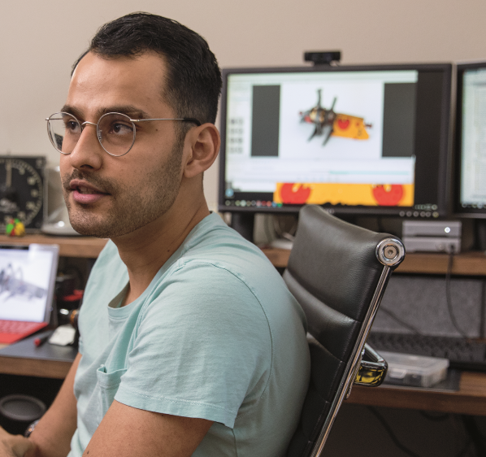









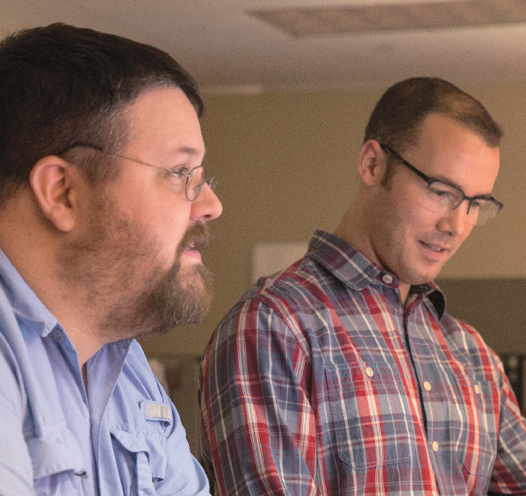
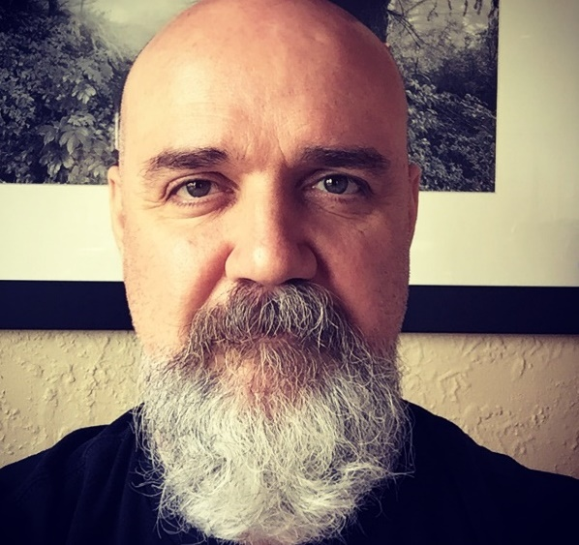

Our antiquated systems prevent me from being agile. I can’t innovate with the rules I have to play by.
It took 3 weeks to get a new dev/test environment.
I’m afraid to change my on-premises environments.
Notes:
As a developer…
These are some of the questions we’ve heard, but we’ve also heard others from developers
Our current infra is stifling innovation – I’m stuck on old hardware, old operating systems, and it’s preventing us from trying something new
Getting a dev/test environment for a new initiative takes forever
My dev/test/prod environments don’t behave the same
We battle constant change of our systems, network, host machines
Fear of change – lack of isolation: to increase VM host machine density, we run multiple apps on the same VM, and I’m worried that updates to one app may affect others

Slide 8
Scale
Inactivity
Period
Compute
On and off
t
Compute
Growing fast
t
Compute
Unpredictable bursting
t
Compute
Predictable bursting
t
Notes:
Applications and environments do not always need to be up and running for 24 hours, seven days a week.
Different workloads typically exhibit different usage patterns and it would be ideal if the underlying infrastructure could adjust automatically to conform to actual requirements.
According to industry reports, development and test infrastructure typically runs at a low utilization rate of approximately 20 percent, which leads to over-provisioning of costly resources when buying hardware exclusively for dev and test purposes.
In a nutshell: if you do not need the compute and storage resources all the time, you should not be forced to pay for them.
That is the beauty of cloud computing: cloud resources can scale based on actual demand. If resources are not needed they are simply switched off and de-commissioned. If they are needed again, then they are brought back, without delay.
Which of these patterns fit your business?

Slide 9


Economics
Individual application
Dev/test environment in the cloud
Application portfolio
All dev/test and production environments in the cloud
Capacity needed (max+20%)
Capacity needed (max+20%)
Save
60-80%
Save
20-30%
S M T W T F S
J F M A M J J A S O N D
Your application portfolio—what does it look like?
On and off (30%)
Growing fast (15%)
Unpredictable bursting (25%)
Pred. bursting (20%)
24x7 steady
Why use the cloud for line of business apps?
Notes:
Cloud economics ensure that you only pay for resources when they are actually used.
The inherent scalability of a cloud infrastructure means that you can scale up and down at any time without limits, depending on your needs.
You will never over-provision for infrastructure again and this in itself will save you money.
Combined with other cloud economic factors—for example the generally lower resource costs due to the massive scale of cloud datacenters—you will realize approximately 30 percent total cost of ownership savings just by moving one individual dev and test environment to the cloud.
Moving one application environment to the cloud is a good starting point, but if you really want to maximize cost savings, it makes sense to look at your entire application portfolio holistically.
If you move multiple workloads to the cloud—also taking into account production environments—you can realize up to 80 percent TCO savings!
KRS
SMLLC

Slide 10
Dev/Test Agility
Dynamically provision environments using templates
Mirror production environments
Tear-down when not in use
Move faster

Slide 11
42
Azure regions
Notes:
Trusted
Azure is continuing expand its infrastructure footprint around the globe.
In fact, Microsoft is the first cloud provider to put data centers in South Africa.
Right now, we’re at 42 Azure regions—which is more than AWS and Google combined.
The approach Azure takes is different as it is important for enterprise customers to have data in region, close to employees, close to customers as well as have unique data handling capabilities.

Slide 12
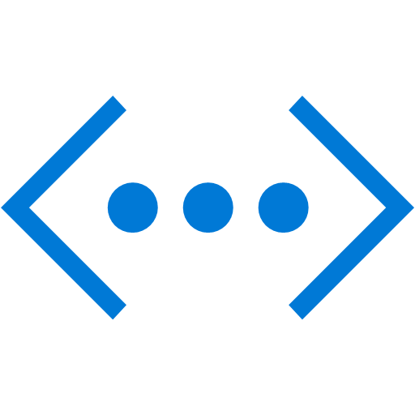

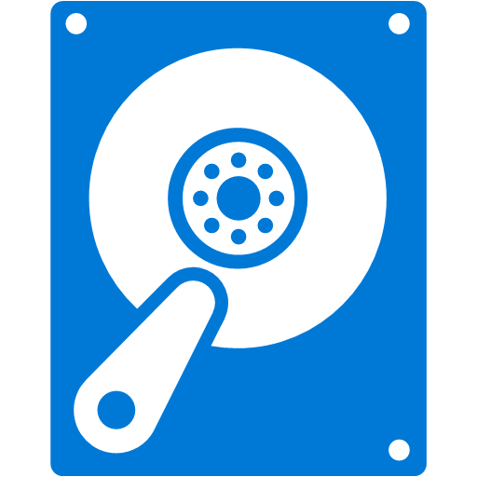
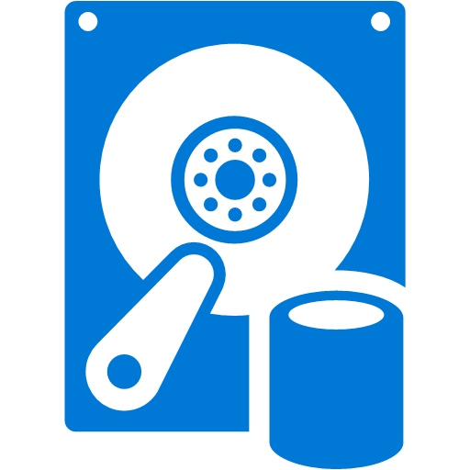

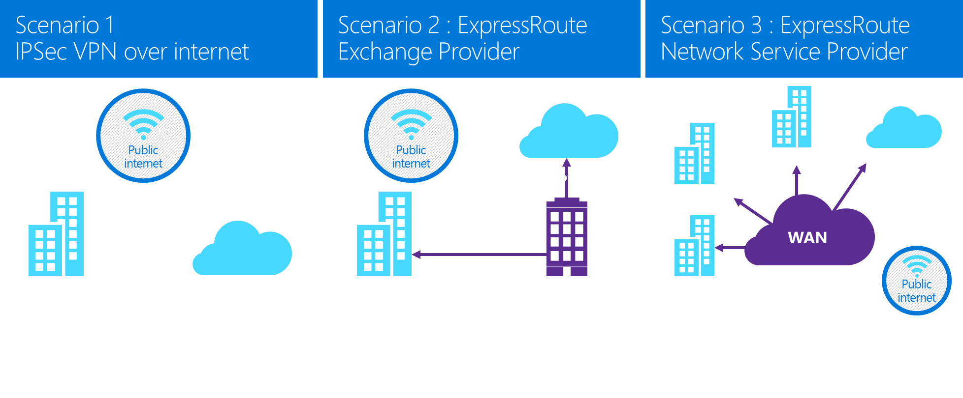









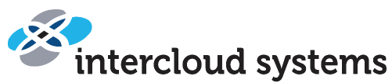



YOUR
DATA CENTER
Self-contained VM-based apps and solutions
AZURE VIRTUAL MACHINES
VIRTUAL
NETWORK
VIRTUALIZED
APP ENVIRONMENTS
STORAGE BLOBS / FILES (Virtual Disks)
25% Existing custom apps
Use this approach as hardware ages and requires a refresh.
50% Self-contained apps
WAYS TO CONNECT YOUR DATA CENTER TO AZURE
10% New business apps
Express Route Partners
15% Packaged apps
Notes:
The story for the next 4 slides is how you should be moving to the cloud. What/how do we adopt the cloud for our environment. Where should I be focusing? What guidance should we be providing? This is the guidance?
Key points:
50% of your Azure usage is infrastructure that moves from on-premises to the cloud
Azure IS an extension of your datacenter
Connect to azure via VPN or ExpressRoute
Once connected, your automation processes just work

Slide 13
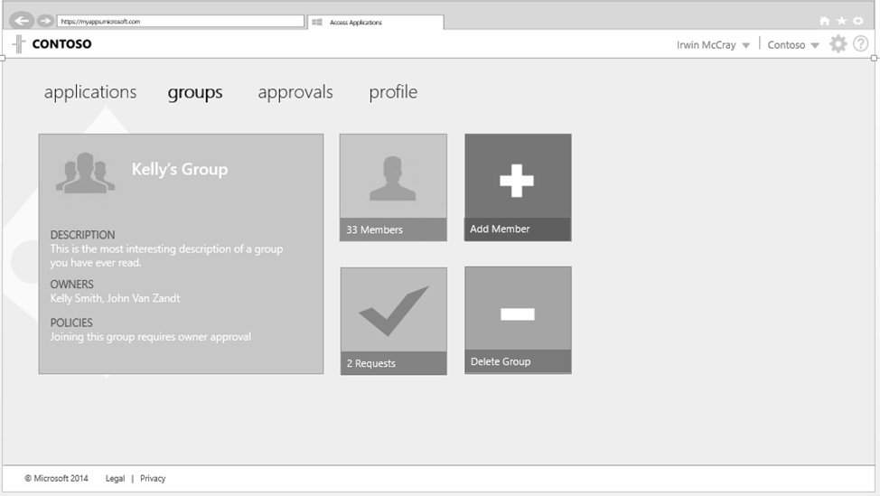
Simple connection
Self-service
Single sign on
Packaged apps
Username
•••••••••••
25% Existing custom apps
50% App operations
Microsoft Azure Active Directory
Windows Server
Active Directory
10% New business apps
15% Packaged apps
Other Directories
SaaS
Azure
Public
cloud
Office 365
Cloud
Your Data Center
Notes:
Packaged apps are typically 3rd party apps that rely on your on-premises identity solution: Active Directory.
It’s common for these packaged apps to support some type of Oauth or SAML-compatible authentication.
For these apps, you integrate your on-premises AD with Azure AD, and using that as the authentication provider.
Example:
KiZAN’s Bonus.ly system – Azure AD integrated using SAML
KiZAN’s Timekeeping system – Legacy Windows Auth

Slide 14
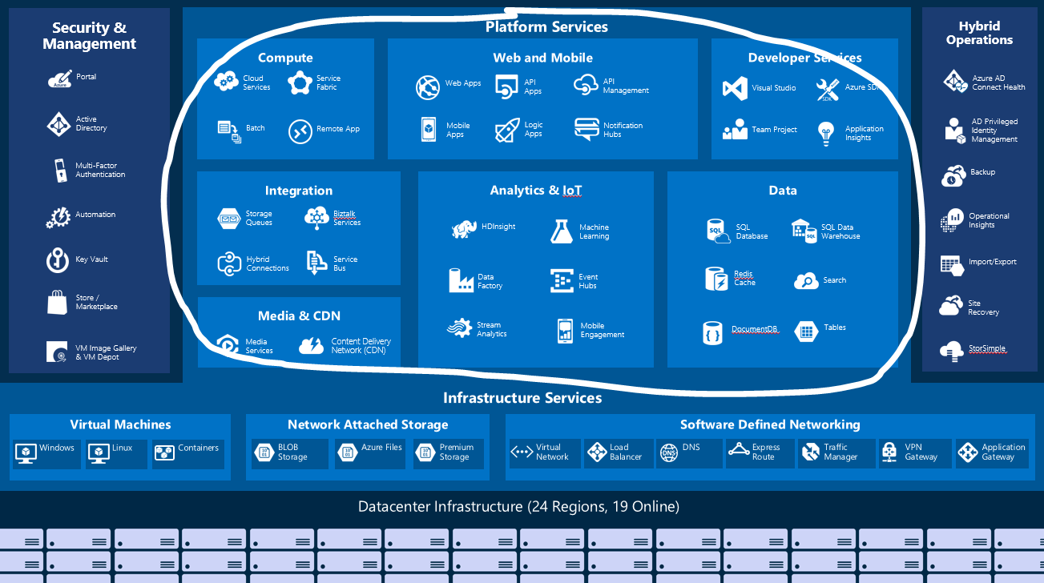
New business applications
25% Existing custom apps
50% App operations
Move up the stack – to PaaS – as much a cultural shift as a technology shift
10% New business apps
15% Packaged apps
Azure handles resilience, servicing, management
Shift to Optimization from deployment/ops
Notes:
IIS -> App Service
NTFS -> Blob Service
Rabbit MQ/NServiceBus -> Service Bus, Event Hubs, Message Queues

Slide 15
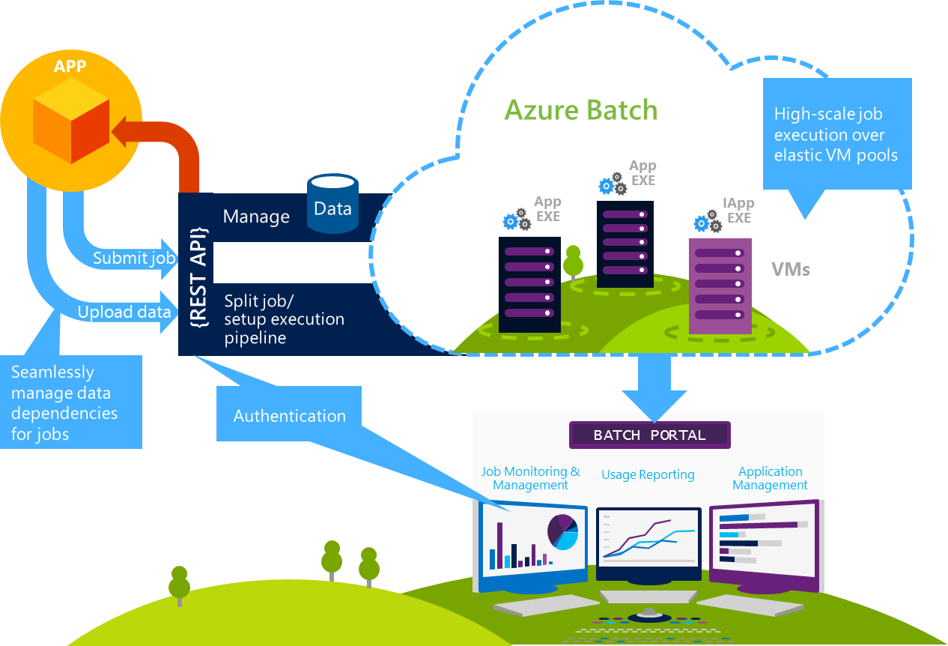
In General – Follow the 6 R’s for Cloud Integration
Existing custom apps
High-value investments:
High Burst/HPC – Expensive, Capacity Constrained Easily Virtualized Apps… HPC Pack, Azure Batch, HPC Hardware
EOL Hardware – Reduce DC footprint -> Azure Virtual Machines
25% Existing custom apps
50% App operations
Cloud-enable apps
Run the applications you use on workstations and clusters today
Run at scale
Batch takes care of starting a pool of compute VMs for you when you’re ready to run a job
Manage delivery
Manage who can access it, how many resources they can use, and ensure requirements such as encryption are met
10% New business apps
15% Packaged apps
Notes:
HPC – Simulations

Slide 16
Readiness

Slide 17
The cloud is changing the world
Option 2

Slide 18
What can we do to be prepared?
Reduce dependency on Windows Authentication
Build more decoupled apps (12-factor apps)
Consider asynchronous app interactions
Don’t share VMs between solutions/apps
Automate your build/release CI/CD pipelines
Notes:
Windows Auth
Azure AD auth, SAML, Oauth, etc.
Separation of Concerns
Decoupled apps
-
Offload from the HTTP compute

Slide 19
Reduce dependencies on Windows Authentication
You tie yourself into an on-premises world
Azure AD can provide SAML, OAuth, etc. auth flows
Microsoft Azure Active Directory
Windows Server
Active Directory
Other Directories
SaaS
Azure
Public
cloud
Office 365
Cloud
Your Data Center

Slide 20
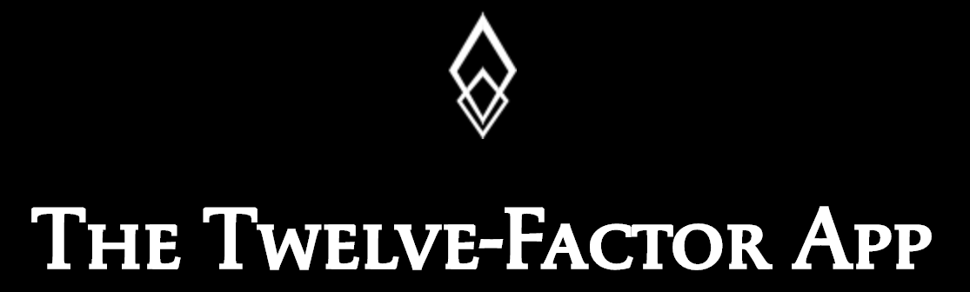
Build more decoupled apps
https://12factor.net
Reduced dependencies between code can decouple infrastructure
Goal is to decouple infrastructure
Think “Separation of Concerns”
Example: Cross-database queries in SQL, fight back with Micro-service approach
Notes:
This is about building scalable cloud architectures that are maintainable

Slide 21




Consider Async App Interactions
Decouple HTTP compute processing into async backend processes
Promotes more efficient scaling in the cloud
Send Email
Send Email
Message Queue
Worker Process

Slide 22
Don‘t share VMs between solutions/apps
Shared VMs promote
environment inconsistencies
“change fatigue”
distressed upgrade/update/patch timelines
You never decommission shared VMs

Slide 23
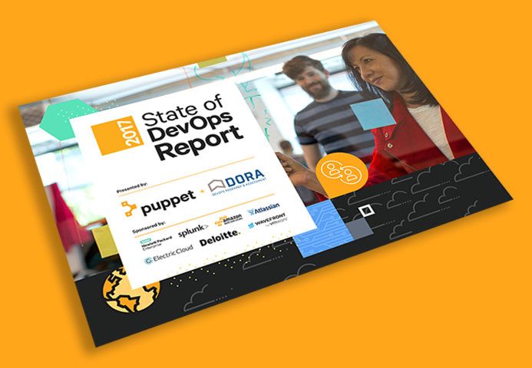
Automate your build/release CI/CD pipelines
Increased automation correlates to
Increased operational maturity
Greater agility
More revenue
Fewer bugs / defects
Faster bug / defect resolution time
Enables you to adapt to cloud deployment & templated environments faster
https://tinyurl.com/sodo2017

Slide 24
Assessment

Slide 25
Cloud Migration Steps
Identity your apps (discover/assess)
Identify your app dependencies
Prioritize migration
Determine migration approach (6 R’s)
Rehost (lift & shift)
Re-platform (lift, tinker, & shift)
Repurchase
Refactor / Rearchitect
Retire
Retain
Notes:
Repurchase: buy a different product

Slide 26
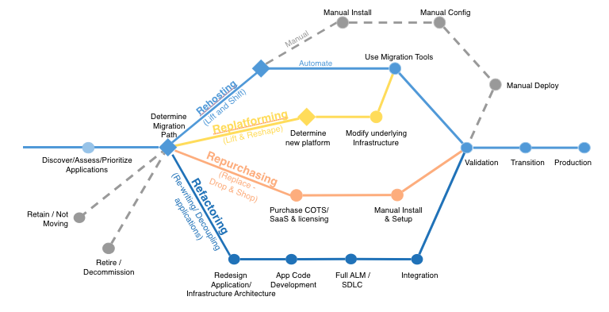
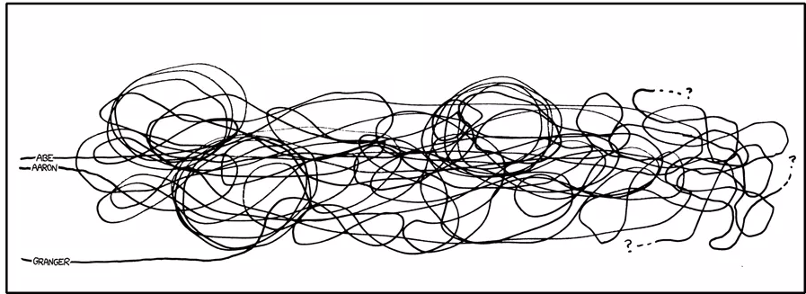
Migration Approaches
Notes:
I like this b/c it’s looks like my commit graph

Slide 27
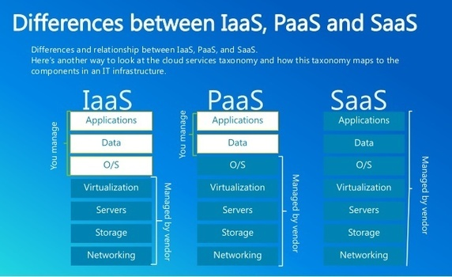
Rearchitecture Paths
Focus on decoupling components
IIS -> Web App
Microservices -> Service Fabric
Kubernetes -> Managed Kub. Cluster
Worker Processes -> Functions
Rabbit MQ, MSMQ -> Queue, Event Hub, Service Bus
NTFS -> Blob Storage
External Session State -> Redis Cache
SQL -> SQL Azure
NoSQL -> CosmosDB

